Slide 1
SECURITY SYSTEM USING ELECTROMAGNETIC LOCK
Group Members
Akhilesh Magdum
Varad Pujari
Kiran Patil

Slide 2
INTRODUCTION
Security describes protection of life and property. There are doors to keep people out, key locks and chains reinforce the mode of security. Doors are being made of metals not wood anymore.
Influential persons in our society have bullet proof doors to ensure a good measure of security of self and family. This has brought about the need to review the need to review the reliability of already of already existing systems and look into the possibility of creating better systems that are smarter and more secure.

Slide 3
SYSTEM DESIGN
The design of a door locking security system using Bluetooth is a complex design which comprises of so many modules (parts) brought together to form the overall design. Each of these modules is made up of discrete components that are joined together to achieve a particular purpose. These separate modules are: The Power Supply Unit, The Buzzer Unit, The micro controller Unit, Telephone unit and Switching.

Slide 4
These different units cannot function alone, they all need to function together to achieve the desired result.
The Bluetooth modem received tone from the Bluetooth network as shown by the direction of the arrow in the diagram below and transmit same to the DTMF decoder but the current value was very small (i.e. about 0.1mA) it was step-up by the tone transformer so that it could be decode by the DTMF decoder which then send the decoded codes to the microcontroller for processing and outputting to relevant component to act
accordingly.

Slide 5
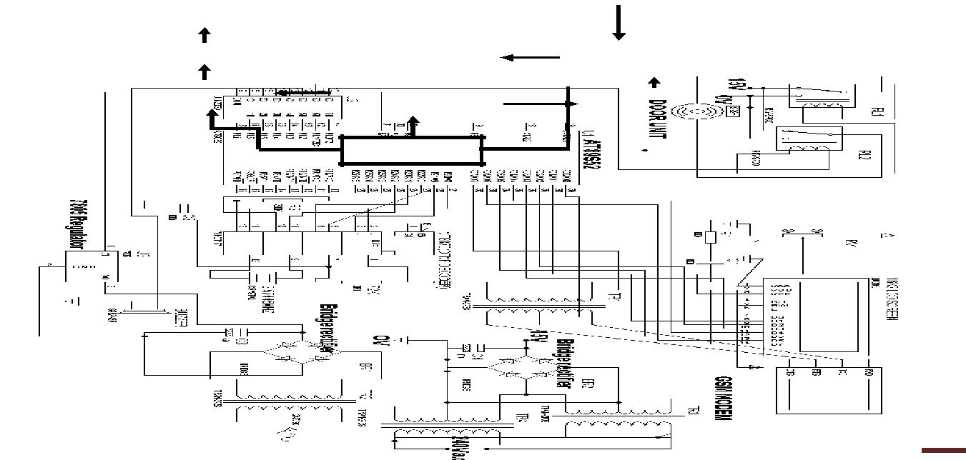

Slide 6
WORKING OF PROJECT
A call is placed to the phone that is connected to the system, this call is like any normal call to a friend, colleague etc. the call made is set to be automatically answered at the other (i.e. door) end, the caller immediately presses six digits numbers (password).
The signal qualities of the tones are first increased by passing it into a step up transformer, the output of which goes to the DTMF decoder.
In the DTMF decoder the tones are received and decoded into a binary code equivalent, the output of the decoder is sent to the microcontroller.
The microcontroller's internal programming processes the output from the DTMF decoder. Here, these decoded signals are identified as the keys pressed on the phone keypad. the microcontroller output these information into three unit

Slide 7
Applications
This locks are often ideal solutions for
Doors that require a basic and/or inexpensive level of security and access control.
Glass Doors that need to electronically control access.
Capability to work with access control systems that will provide access and egress.

Slide 8
THANK YOU

